Slide 1


Anton Rechenauer
May 28th 2022

Slide 2

Outline
Executive Summary
Introduction
Methodology
Results
Conclusion
Appendix

Slide 3
Executive Summary
Summary of methodologies
Data Collection classical style (CSV files)
Data Collection using web scraping (from Wikipedia)
Data Wrangling and Cleaning
Exploring the data - SQL, Visualizations, GIS(Folium)
Building an interactive dashboard
Prediction (here: Classification) using Machine Learning
Summary of all results
Data Analysis results: success is more likely for light payload
Discussion of the quality of the predictions from ML – we can achieve an accuracy of more than 80%

Slide 4
Introduction
Project background and context: SpaceX made payload transport to an orbit cheap – they can reuse the first stage (aka “Stage One”) of their rocket Falcon9. This cuts down the cost from $165m to $62m per launch! But there are still a lot of unsuccessful attempts to recover the first stage!
This raises an obvious question: Can we find out the conditions or parameters for a successful recovery of Stage One? Is there a – explainable - reason why it sometimes fails?
A first baby step is to check whether we can predict success/failure!

Slide 5

Section 1

Slide 6
Methodology
Executive Summary
Data collection methodology:
Collect rocket launch data via REST-API from SpaceX, get data from web scraping on Wikipedia
Perform data wrangling
Modify and add Columns, remove outliers, discuss missing data, One-Hot Encoding etc.
Perform exploratory data analysis (EDA) using visualization and SQL
Perform interactive visual analytics using Folium and an interactive dashboard
Perform predictive analysis using classification models
We do the usual Test/Train split and then train several classification models to predict success or failure of recovery.
For each model the best hyperparameters are found using cross-validation
We finally compare the accuracy of these models using test data

Slide 7
Data Collection
Data Collection “SpaceX” SpaceX provides a REST-API where several JSON-files (data about the rockets, payloads, launchpad, cores) files could be downloaded. These where combined, filtered for the falcon9 data and then exported in csv format.
Data Collection “Wikipedia” Python libraries were used to retrieve the HTML of a relevant webpage (as text) and the launch related data was extracted using the famous library htmlsoup.

Slide 8
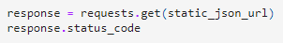
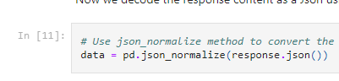
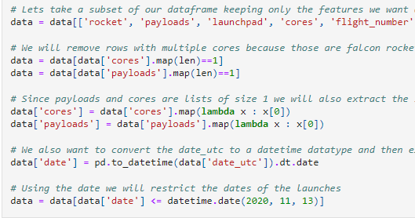
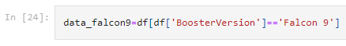

Data Collection – SpaceX API
GitHub Link https://github.com/Bleiglanz/Capstone_SpaceX/blob/main/jupyter-labs-spacex-data-collection-api.ipynb
get JSON from server
Normalize and convert to dataframe
Transform and combine to final dataframe
filter and export csv

Slide 9
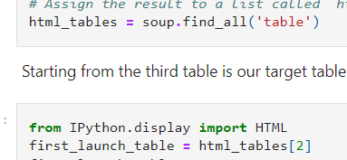
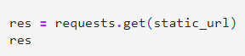
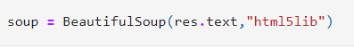
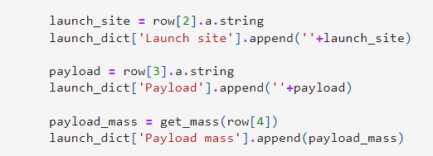
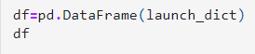

Data Collection – Web Scraping from Wikipedia
GitHub https://github.com/Bleiglanz/Capstone_SpaceX/blob/main/jupyter-labs-webscraping.ipynb
get HTML text
soupify
Get tables and columns
Build a dictionary from columns
Transform
Dictionary to dataframe
Export to csv

Slide 10
Data Wrangling
Exploratory Data Analysis (EDA) is the process of cleaning, unifying and understanding complex data.
The goal is insight into the data, it’s structure and discovery possible problems.
In this project:
Find number of launches at each site
Find the orbit for each launch
Work out the success rates (Labels)
GitHub https://github.com/Bleiglanz/Capstone_SpaceX/blob/main/labs-jupyter-spacex-Data-wrangling.ipynb

Slide 11
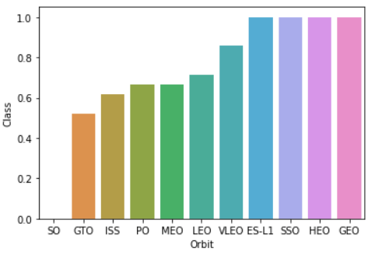
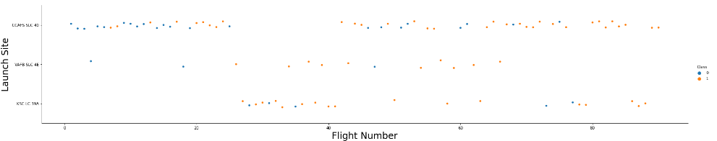
EDA with Data Visualization
GitHub: https://github.com/Bleiglanz/Capstone_SpaceX/blob/main/jupyter-labs-eda-dataviz.ipynb
Examples: flight vs. launch site, success vs. orbit
The following scatter plots were created:
Payload Mass / Flight Number Launch Site / Flight Number Launch Site / Payload Mass Orbit / Flight Number, Playload / Orbit
In addition, we created a bar graph (Success Rate / Orbit) and a Line Graph (Success Rate / Year)

Slide 12
EDA with SQL: We performed several queries
GITHUB https://github.com/Bleiglanz/Capstone_SpaceX/blob/main/jupyter-labs-eda-sql-coursera.ipynb
Names of unique launch sites
Five records where launch sites begin with CCA
Total payload mass carried by boosters launched by NASA (CRS)
Average payload mass carried by booster F9 v1.1.
Date of first successful landing outcome in ground pad
Name of boosters successfully recovered in drone ship and have payload mass >= 4000 and <= 6000.
Count of successful and failure mission outcomes.
Names of the Boosters of maximum payload mass.
List the records which will display the month names, failures in drone ship, booster versions in 2015.
Rank successful landing between the date 04-06-2010 and 20-03-2017 in descending order.
Hint to grader: My Watson account was blocked, I used sqlite!

Slide 13
Interactive Map with Folium
GitHub https://github.com/Bleiglanz/Capstone_SpaceX/blob/main/lab_jupyter_launch_site_location_folium.ipynb
We used Folium to add Markers, Circles and Lines to an interactive map showing the launch sites of the Falcon9 rocket
Markers indicate points (here: launch sites) and the frequency of launches at each site (green=successful recovery of Stage One for this launch, red=failure of recovery)
Circles were used to highlight areas
Lines were used to indicate distances (closest proximity to coastline, city, railway etc)

Slide 14
Dashboard with Plotly Dash
GitHub https://github.com/Bleiglanz/Capstone_SpaceX/blob/main/dashboard/spacex_dash_app.py
The dashboard contains to graphs: A pie chart showing the total number of launches by a site (or all of them combined). For a selected launch site, the pie chart showed a breakdown of launches (successful/failures) A scatter plot of the outcome (successful recovery of Stage One or not) versus the payload mass. The bound of the mass can be interactively changed by the user.

Slide 15
Predictive Analysis (Classification)
Summarize how you built, evaluated, improved, and found the best performing classification model
You need present your model development process using key phrases and flowchart
Add the GitHub URL of your completed predictive analysis lab, as an external reference and peer-review purpose

Slide 16
Results
Exploratory data analysis results
Interactive analytics demo in screenshots
Predictive analysis results

Slide 17

Section 2

Slide 18
Flight Number vs. Launch Site
Show a scatter plot of Flight Number vs. Launch Site
Show the screenshot of the scatter plot with explanations

Slide 19
Payload vs. Launch Site
Show a scatter plot of Payload vs. Launch Site
Show the screenshot of the scatter plot with explanations

Slide 20
Success Rate vs. Orbit Type
Show a bar chart for the success rate of each orbit type
Show the screenshot of the scatter plot with explanations

Slide 21
Flight Number vs. Orbit Type
Show a scatter point of Flight number vs. Orbit type
Show the screenshot of the scatter plot with explanations

Slide 22
Payload vs. Orbit Type
Show a scatter point of payload vs. orbit type
Show the screenshot of the scatter plot with explanations

Slide 23
Launch Success Yearly Trend
Show a line chart of yearly average success rate
Show the screenshot of the scatter plot with explanations

Slide 24
All Launch Site Names
Find the names of the unique launch sites
Present your query result with a short explanation here

Slide 25
Launch Site Names Begin with 'CCA'
Find 5 records where launch sites begin with `CCA`
Present your query result with a short explanation here

Slide 26
Total Payload Mass
Calculate the total payload carried by boosters from NASA
Present your query result with a short explanation here

Slide 27
Average Payload Mass by F9 v1.1
Calculate the average payload mass carried by booster version F9 v1.1
Present your query result with a short explanation here

Slide 28
First Successful Ground Landing Date
Find the dates of the first successful landing outcome on ground pad
Present your query result with a short explanation here

Slide 29
Successful Drone Ship Landing with Payload between 4000 and 6000
List the names of boosters which have successfully landed on drone ship and had payload mass greater than 4000 but less than 6000
Present your query result with a short explanation here

Slide 30
Total Number of Successful and Failure Mission Outcomes
Calculate the total number of successful and failure mission outcomes
Present your query result with a short explanation here

Slide 31
Boosters Carried Maximum Payload
List the names of the booster which have carried the maximum payload mass
Present your query result with a short explanation here

Slide 32
2015 Launch Records
List the failed landing_outcomes in drone ship, their booster versions, and launch site names for in year 2015
Present your query result with a short explanation here

Slide 33
Rank Landing Outcomes Between 2010-06-04 and 2017-03-20
Rank the count of landing outcomes (such as Failure (drone ship) or Success (ground pad)) between the date 2010-06-04 and 2017-03-20, in descending order
Present your query result with a short explanation here

Slide 34

Section 3

Slide 35
<Folium Map Screenshot 1>
Replace <Folium map screenshot 1> title with an appropriate title
Explore the generated folium map and make a proper screenshot to include all launch sites’ location markers on a global map
Explain the important elements and findings on the screenshot

Slide 36
<Folium Map Screenshot 2>
Replace <Folium map screenshot 2> title with an appropriate title
Explore the folium map and make a proper screenshot to show the color-labeled launch outcomes on the map
Explain the important elements and findings on the screenshot

Slide 37
<Folium Map Screenshot 3>
Replace <Folium map screenshot 3> title with an appropriate title
Explore the generated folium map and show the screenshot of a selected launch site to its proximities such as railway, highway, coastline, with distance calculated and displayed
Explain the important elements and findings on the screenshot

Slide 38

Section 4

Slide 39
<Dashboard Screenshot 1>
Replace <Dashboard screenshot 1> title with an appropriate title
Show the screenshot of launch success count for all sites, in a piechart
Explain the important elements and findings on the screenshot

Slide 40
<Dashboard Screenshot 2>
Replace <Dashboard screenshot 2> title with an appropriate title
Show the screenshot of the piechart for the launch site with highest launch success ratio
Explain the important elements and findings on the screenshot

Slide 41
<Dashboard Screenshot 3>
Replace <Dashboard screenshot 3> title with an appropriate title
Show screenshots of Payload vs. Launch Outcome scatter plot for all sites, with different payload selected in the range slider
Explain the important elements and findings on the screenshot, such as which payload range or booster version have the largest success rate, etc.

Slide 42

Section 5

Slide 43
Classification Accuracy
Visualize the built model accuracy for all built classification models, in a bar chart
Find which model has the highest classification accuracy

Slide 44
Confusion Matrix
Show the confusion matrix of the best performing model with an explanation

Slide 45
Conclusions
Point 1
Point 2
Point 3
Point 4
…

Slide 46
Appendix
Include any relevant assets like Python code snippets, SQL queries, charts, Notebook outputs, or data sets that you may have created during this project

Slide 47


